Slide 1



SMART-PAID
AI-DRIVEN DIAGNOSTIC AND TREATMENT SYSTEM FOR PNEUMONIA
Driving Innovation for Tomorrow
Presented by Mr. Sanni Kumar
Department of CSE

Slide 2

INTRODUCTION TO SMART-PAID
  Pneumonia is a severe respiratory disease
  Late diagnosis increases health risks.
  This is especially true in rural areas.
  SMART-PAID offers accessible care.
  It uses AI for detection and treatment
  This system aims to save lives.

Slide 3






INSIGHTS FROM LITERATURE REVIEW
Global Health Need
AI Accuracy
Telemedicine Impact
Voice AI & Engagement
Early Detection
WHO (2021) highlighted the urgent need for accessible pneumonia diagnostic tools.
Smith et al. (2020) demonstrated AI's over 90% accuracy in X-ray analysis.
Patel & Lee (2019) showed telemedicine improves rural healthcare access.
Chen et al. (2022) found voice AI enhances patient engagement significantly.
Jones et al. (2020) confirmed symptom checkers aid in early disease detection.

Slide 4




CORE TECHNOLOGIES EMPLOYED
Frontend Stack
Backend Solutions
AI & ML Core
Hosting & Tools
React.js, HTML, CSS, JavaScript
Node.js, PHP, Express.js
OpenAI GPT, Python (X-ray analysis)
Netlify, Firebase, LiveKit, ElevenLabs

Slide 5
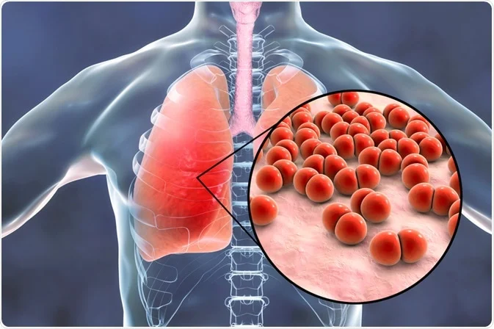
Voice Assistant Algorithm
  Capture speech
  Convert to text (STT)
  Analyze with OpenAI
  Return diagnosis (Safe / Moderate / Risk)
KEY ALGORITHMS FOR DIAGNOSIS
Chatbot Algorithm
Similar to voice, handles typed input.
Appointment Booking Algorithm
Via WhatsApp or Form (PHP/Node)

Slide 6

MECHANISM AND WORKING
User inputs symptoms via voice/chat.
AI evaluates symptoms or uploaded X-ray.
Risk level is categorized.
Users receive prevention/treatment tips or book a doctor’s appointment.

Slide 7
TESTING
Unit Testing
Integration Testing
Validation
Outcome
Individual modules, such as chat functions and forms, undergo thorough testing.
End-to-end flow, from symptom input to treatment, is comprehensively tested.
Cross-browser compatibility, mobile responsiveness, and multilingual support are validated.
Testing resulted in high diagnostic accuracy and rapid user feedback delivery.

Slide 8


RESULTS & FEATURES
  Multilingual AI assistant (voice + chat)
  Symptom checker and X-ray analysis
  Telemedicine integration via WhatsApp
  Treatment and prevention guidance
  Improved user engagement and accessibility

Slide 9
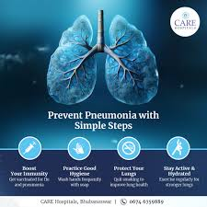

CONCLUSION & FUTURE SCOPE
SMART-PAID is a scalable, accurate, and user-centric solution, poised to transform pneumonia diagnosis and treatment globally.
Scalable
AI-driven diagnosis for underserved areas.
User-centric
Awareness campaigns and full telemedicine suite.

Slide 10


LET'S CONNECT
Contact
Information
  +91 6362527976
THANK YOU !
  Sannikumar@sitgulbarga.org
  Shetty Institute of Technology, Kalaburagi

